Slide 1
GAS LEAK DETECTION SYSTEM
CSE - 306 (MPMC Sessional)
PRESENTED BY: GROUP 2 B
Anika Siddiqui 201814013
Shutonu Mitra 201814033
Mosammat Hridita Jalal 201814045
Samihat Islam 201814049

Slide 2
OUR IDEA
An IoT based system capable of detecting gas leaks and sending alert message via SMS to the user's cellphone as well as triggering an alarm.

Slide 3
OBJECTIVES
Build an IoT based gas detecting and alerting system
Detect LPG, natural gas, coal gas and smoke
Trigger an alarm to alert nearby people if any leak is detected
Notify user via SMS of the gas leak

Slide 4
COMPONENTS
COMPONENT | QUANTITY | PRICE (Taka)
Arduino Uno R3 | 1 pc | 450
GSM Module SIM900A Mini | 1 pc | 1750
LCD Display | 1 pc | 180
Gas Sensor MQ5 | 1 pc | 140
Breadboard | 1 pc | 65
Breadboard Power Supply Module | 1 pc | 95
Potentiometer 10K | 1 pc | 20
Jumper Wires | 40 pcs | 90

Slide 5
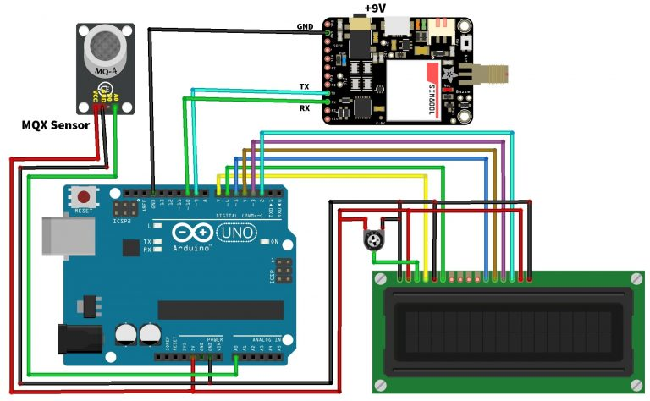
CIRCUIT DIAGRAM
MQ5
+5V

Slide 6
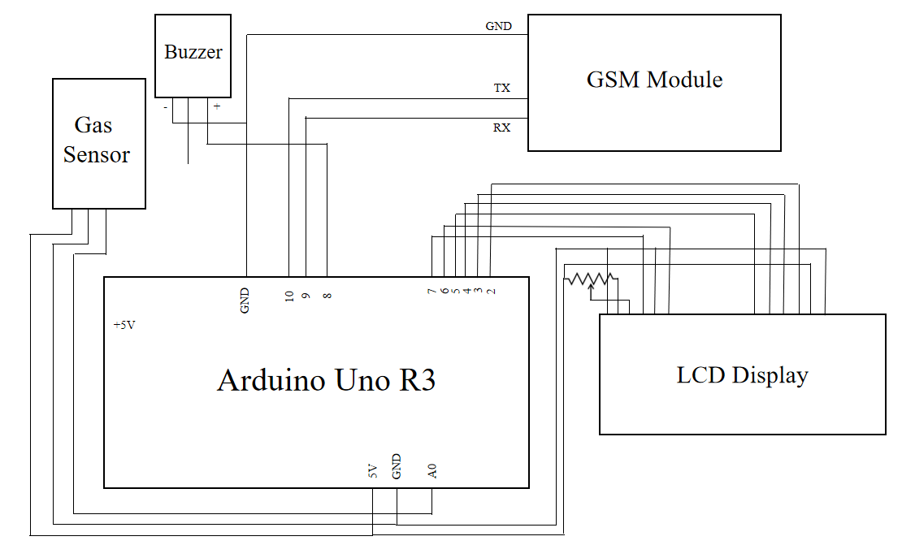
PIN DIAGRAM

Slide 7
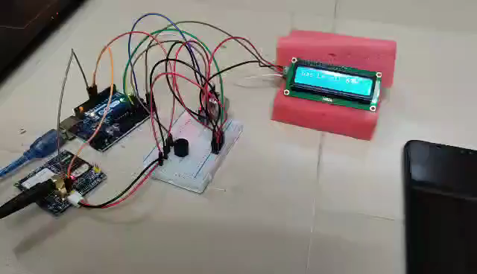
DEMONSTRATION

Slide 8
DESCRIPTION
The circuit is powered on after uploading code, the LCD displays the Gas Level (normal or excessive)
The circuit triggers the alert system when smoke or gas leakage is detected
When the gas level exceeds it will display SMS Sent status
The signal is monitored by the microcontroller and sends the signal to the GSM module Sim800 to send messages as “ALERT! Excess Gas Detected. Open Windows Immediately” to a mobile number written in code

Slide 9
QUESTIONS

Slide 10
THANK YOU

